Slide 1
NIST (National Institute of Standards and Technology) Cloud Computing Reference Architecture Dr. Brijendra Singh

Slide 2
NIST cloud computing reference architecture
It identifies the major actors, their activities and functions in cloud computing.
The following diagram depicts a generic high-level architecture and is intended to facilitate the understanding of the requirements, uses, characteristics and standards of cloud computing.

Slide 3
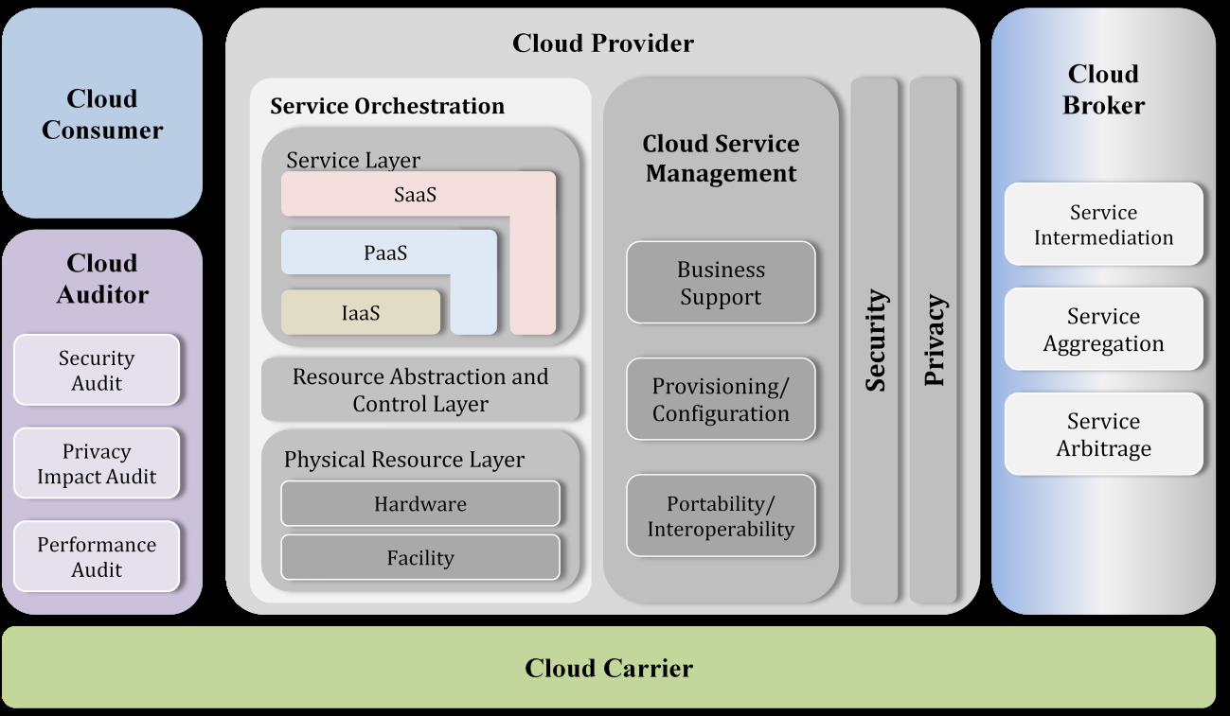

Slide 4
NIST cloud computing reference architecture
The NIST cloud computing reference architecture defines five major actors: cloud consumer, cloud provider, cloud carrier, cloud auditor and cloud broker.
Each actor is an entity (a person or an organization) that participates in a transaction or process and/or performs tasks in cloud computing.

Slide 5
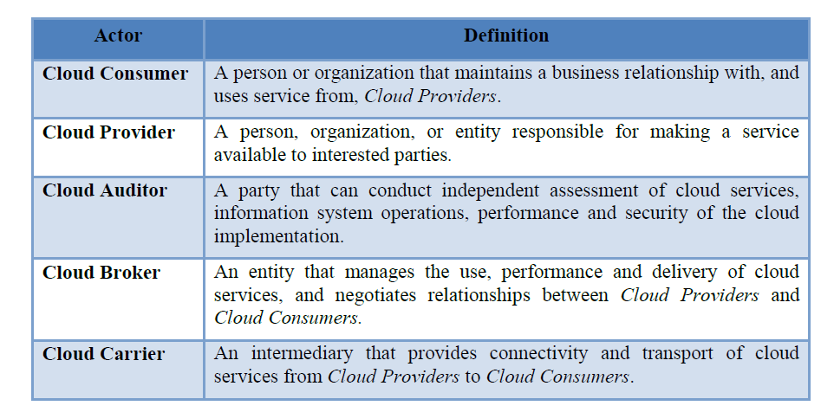
Actors in Cloud Computing

Slide 6
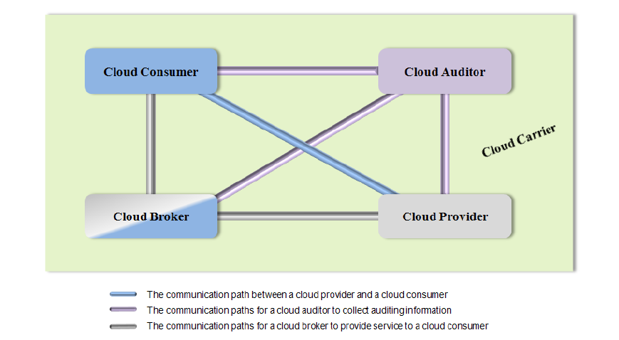
Interactions between the Actors in Cloud Computing

Slide 7
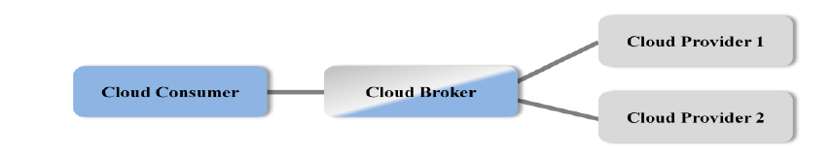
Example Usage Scenario 1:
A cloud consumer may request service from a cloud broker instead of contacting a cloud provider directly.
The cloud broker may create a new service by combining multiple services or by enhancing an existing service.
In this example, the actual cloud providers are invisible to the cloud consumer and the cloud consumer interacts directly with the cloud broker.

Slide 8
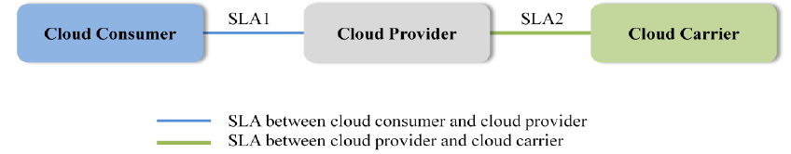
Example Usage Scenario 2:
Cloud carriers provide the connectivity and transport of cloud services from cloud providers to cloud consumers.
A cloud provider participates in and arranges for two unique service level agreements (SLAs), one with a cloud carrier (e.g. SLA2) and one with a cloud consumer (e.g. SLA1).
A cloud provider arranges service level agreements (SLAs) with a cloud carrier and may request dedicated and encrypted connections to ensure the cloud services are consumed at a consistent level according to the contractual obligations with the cloud consumers.
In this case, the provider may specify its requirements on capability, flexibility and functionality in SLA2 in order to provide essential requirements in SLA1.

Slide 9
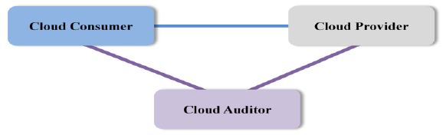
Example Usage Scenario 3:
For a cloud service, a cloud auditor conducts independent assessments of the operation and security of the cloud service implementation.
The audit may involve interactions with both the Cloud Consumer and the Cloud Provider.

Slide 10
1. Cloud Consumer
The cloud consumer is the principal stakeholder for the cloud computing service.
A cloud consumer represents a person or organization that maintains a business relationship with, and uses the service from a cloud provider.
A cloud consumer browses the service catalog from a cloud provider, requests the appropriate service, sets up service contracts with the cloud provider, and uses the service.
The cloud consumer may be billed for the service provisioned, and needs to arrange payments accordingly.

Slide 11
Cloud Consumer
Cloud consumers need SLAs to specify the technical performance requirements fulfilled by a cloud provider. SLAs can cover terms regarding the quality of service, security, remedies for performance failures.
A cloud provider may also list in the SLAs a set of promises explicitly not made to consumers, i.e. limitations, and obligations that cloud consumers must accept.
A cloud consumer can freely choose a cloud provider with better pricing.
Typically a cloud provider’s pricing policy and SLAs are non-negotiable, unless the customer expects heavy usage and might be able to negotiate for better contracts.

Slide 12
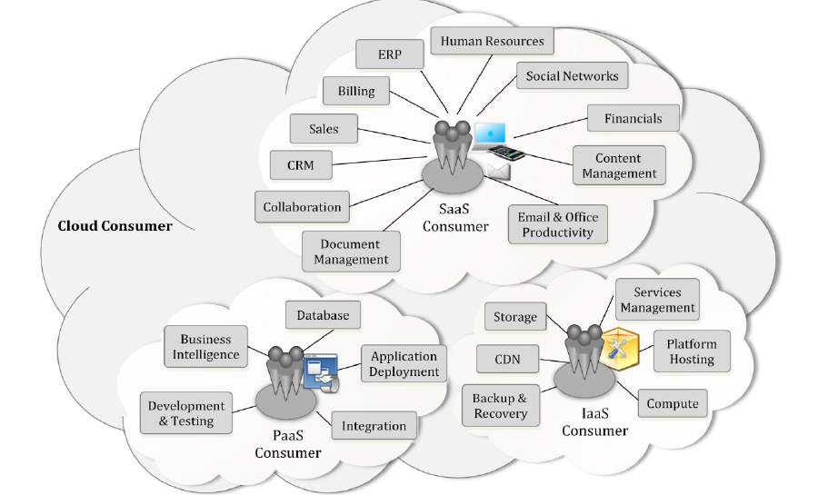
Example Services Available to a Cloud Consumer

Slide 13
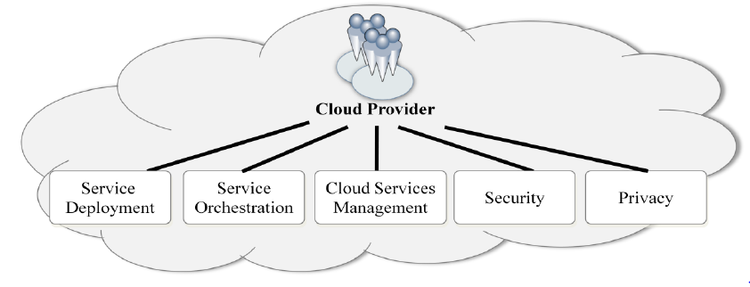
2. Cloud Provider –Major activities
A cloud provider is a person, an organization; it is the entity responsible for making a service available to interested parties.
A Cloud Provider acquires and manages the computing infrastructure required for providing the services, runs the cloud software that provides the services, and makes arrangement to deliver the cloud services to the Cloud Consumers through network access.

Slide 14
Cloud Provider
Service Deployment:
A cloud infrastructure may be operated in one of the following deployment models: public cloud, private cloud, community cloud, or hybrid cloud.
Service Orchestration :
Service Orchestration refers to the composition of system components to support the Cloud Providers activities in arrangement, coordination and management of computing resources in order to provide cloud services to Cloud Consumers.
A three-layered model is used in this representation, representing the grouping of three types of system components Cloud Providers need to compose to deliver their services.

Slide 15
A three-layered model
(i) Service Layer: IaaS, PaaS, SaaS
(ii) The middle layer in the model is the resource abstraction and control layer. This layer contains the system components that Cloud Providers use to provide and manage access to the physical computing resources through software abstraction. Examples of resource abstraction components include software elements such as hypervisors, virtual machines, virtual data storage, and other computing resource abstractions.
The resource abstraction needs to ensure efficient, secure, and reliable usage of the underlying physical resources.
The control aspect of this layer refers to the software components that are responsible for resource allocation, access control, and usage monitoring.

Slide 16
A three-layered model
(iii) The lowest layer in the stack is the physical resource layer, which includes all the physical computing resources.
This layer includes hardware resources, such as computers (CPU and memory), networks (routers, firewalls, switches, network links and interfaces), storage components (hard disks) and other physical computing infrastructure elements.
It also includes facility resources, such as heating, ventilation and air conditioning , power, communications, and other aspects of the physical plant.

Slide 17
Cloud Service Management
Business Support
Business Support entails the set of business-related services dealing with clients and supporting processes. It includes the components used to run business operations that are client-facing.
Customer management: Manage customer accounts, open/close/terminate accounts, manage user profiles, manage customer relationships by providing points-of-contact and resolving customer issues and problems, etc.
Contract management: Manage service contracts, setup/negotiate/close/terminate contract, etc.
Inventory Management: Set up and manage service catalogs, etc.
Accounting and Billing: Manage customer billing information, send billing statements, process received payments, track invoices, etc.
Reporting and Auditing: Monitor user operations, generate reports, etc.

Slide 18
Cloud Service Management
Provisioning and Configuration
Rapid provisioning: Automatically deploying cloud systems based on the requested service/resources/capabilities.
Resource changing: Adjusting configuration/resource assignment for repairs, upgrades and joining new nodes into the cloud.
Monitoring and Reporting: Discovering and monitoring virtual resources, monitoring cloud operations and events and generating performance reports.
Metering: Providing a metering capability at some level of abstraction appropriate to the type of service (e.g., storage, processing, bandwidth, and active user accounts).
SLA management: Encompassing the SLA contract definition (basic schema with the QoS parameters), SLA monitoring and SLA enforcement according to defined policies.

Slide 19
Cloud Service Management
Portability and Interoperability
For portability, prospective customers are interested to know whether they can move their data or applications across multiple cloud environments at low cost and minimal disruption.
From an interoperability perspective, users are concerned about the capability to communicate between or among multiple clouds.

Slide 20
3. Cloud Auditor
A cloud auditor is a party that can perform an independent examination of cloud service controls with the intent to express an opinion thereon.
A cloud auditor can evaluate the services provided by a cloud provider in terms of security controls, privacy impact, performance, etc.

Slide 21
4. Cloud Broker
As cloud computing evolves, the integration of cloud services can be too complex for cloud consumers to manage.
A cloud consumer may request cloud services from a cloud broker, instead of contacting a cloud provider directly.
A cloud broker is an entity that manages the use, performance and delivery of cloud services and negotiates relationships between cloud providers and cloud consumers.

Slide 22
In general, a cloud broker can provide services in three categories :
Service Intermediation: A cloud broker enhances a given service by improving some specific capability and providing value-added services to cloud consumers. The improvement can be managing access to cloud services, performance reporting, enhanced security, etc.
Service Aggregation: A cloud broker combines and integrates multiple services into one or more new services. The broker provides data integration and ensures the secure data movement between the cloud consumer and multiple cloud providers.
Service Arbitrage: Service arbitrage is similar to service aggregation except that the services being aggregated are not fixed. Service arbitrage means a broker has the flexibility to choose services from multiple agencies.

Slide 23
5. Cloud Carrier
A cloud carrier acts as an intermediary that provides connectivity and transport of cloud services between cloud consumers and cloud providers.
Cloud carriers provide access to consumers through network, telecommunication and other access devices.
For example, cloud consumers can obtain cloud services through network access devices, such as computers, laptops, mobile phones, mobile Internet devices (MIDs), etc

